Slide 1

Automatic Question Paper Generator System
Group No. 6
AnmolSingh Paman-18204003
Rahul Rahi-17104057
Abhishek Jha- 18204008
Project Guide – Prof. Yaminee Patil

Slide 2
Contents
Introduction
Objectives
Problem Definition
Technological Stack
Review Suggestions
Proposed System Architecture/Working
Prototype Design Demonstration
Plan of Paper Publication

Slide 3
Introduction
Question Paper Generator is a special and unique software, which could be used in schools, institutions, colleges, where test paper setters will have a huge database of questions for frequent generation of question.
This software can be implemented in various medical, engineering and coaching institutes for theory paper.
You can create random question paper with this software anytime within seconds.
You can enter unlimited units and chapter depending upon the system storage, capacity and as per the requirement.

Slide 4
Objectives
Question entered in the database should fulfil the Course Objectives and should cover the Syllabus.
Question Paper formed should address the desired Course Objectives
Question Paper formed should follow Blooms Taxonomy
Question Paper formed should be confirmed by the NBA co-ordinator.
Export questions from the system directly to Moodle

Slide 5
Problem Definition
The existing system for Question Paper Generation requires human staff to chalk out questions that appear in the question paper. Question Paper creation is a tedious and time consuming task
To create a system which reduces Human Working process and also The Instructor to generate and Save The Question Paper Automatically.

Slide 6
Technological Stack
HARDWARE
Processor type: Minimum:- Intel Pentium 3/ Pentium 4
Recommended:- Intel Core 2 duo or higher
Processor Speed:- 2.1Ghz or more
RAM:- Minimum:- 2GB DDR3 RAM
Recommended:- 4GB DDR3 RAM
Hard Disk Space:- 160GB Hard Disk space

Slide 7
Technological Stack
SOFTWARE
Operating System: Windows XP/2000/Vista/7/8/10 or Linux or MacOS
Languages used: PHP, JavaScript, HTML, CSS, XML
Algorithm Used- Shuffling Algorithm
Database:- MySQL Database
Browser:- Testing Enviornment

Slide 8
Review Suggestions
Change of Introduction.
Change of Objectives.
Change in Problem Definition.
Knowledge about Bloom’s Taxonomy.
Highlighting CO Mapping in Project.
Question Paper Format to be confirmed by NBA co-ordinator.

Slide 9
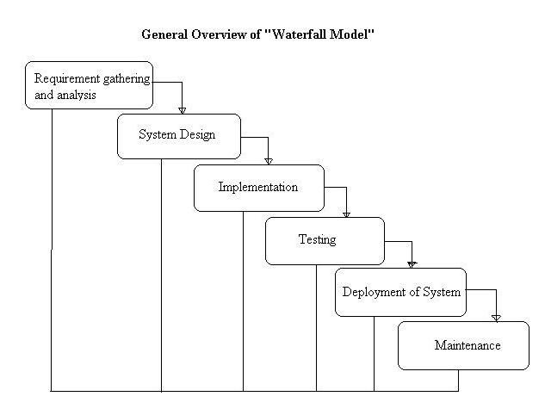
Proposed System Architecture/Working Process Model: Waterfall Model

Slide 10
Proposed System Architecture/Working
Considering the short coming of conventional system, an eager need was felt to redesign the whole system.
Automatic Question Paper Generator is a special software which is useful to schools, Institutes, publishers and test paper.
It mainly deals with the gathering, sorting and administration of a large amount of questions about different levels of toughness from scientific as well as non-scientific subjects related to various classes
The main aim of our system is to provide randomization technique with the help of Shuffling Algorithm in question paper generation system fulfilling the Course Objectives according to the Bloom’s Taxonomy, thus different sets of question could be generated without repetition and duplication and could be sent to the NBA co-ordinator for confirmation and approval.
Security Features:-
a. Password facility to ensure validity of user
b. Data Secrecy

Slide 11
Proposed System Architecture/Working
Working of the Proposed System:
User can register itself on the system on the registration page, wherein the user has to enter name, Email id and Password or can directly click on the Google Registration to login using the users Gmail id.
Before user is able to access system, it is necessary to pass the authentication step through login form where user must enter the correct username and password given by system administrator. If user has administrator role, login form will redirect to Admin Portal. If login details match a Faculty role, user will be redirected to Faculty Portal.
The user can login to the portal using the login form where the authorized user is allowed to login. the user needs to enter username and the password. The user can be of 2 types. Here its either the faculty or the admin.

Slide 12
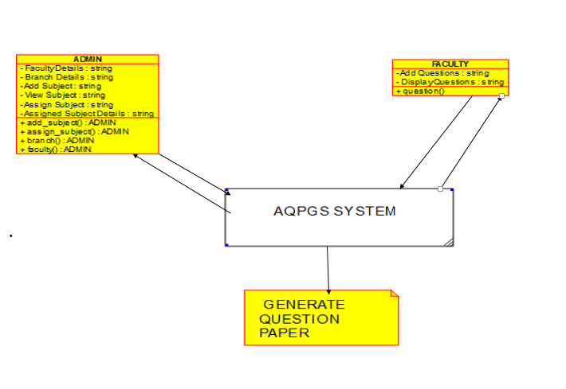
Proposed System Architecture/Working
Working of the Proposed System:

Slide 13
Proposed System Architecture/Working
Working of the Proposed System:
If the user is admin then the privileges are :-
1) Faculty details : In this admin has the power to approve or disapprove faculty or even delete faculty on clicking the respective button.
2) Branch details: In this the new branches can be added using the branch name and click on the add branch button.it can be checked with the list given below. It can also be deleted later if no longer required.
3) Add subject: In this new subject can be added by entering new subject name, choosing the respective branch and finally click on the add subject button.
4) View subject: view the list of subjects available. Admin can also search using subject name. Or delete it.
5) Assign subject: click on the dropdown menu, select the faculty from the list and click search. a box appears where the subject must be chosen and click on assign button.
6) Assigned subject details: it displays subject name, also it has the faculty record button which shows the list of faculty assigned to particular subject. Delete button is used to remove the faculty assigned to particular subject.

Slide 14
Proposed System Architecture/Working
Working of the Proposed System:
If the user is faculty then the privileges are:-
1) Add Questions: User can add question for a particular subject which is assigned by the admin to the user.
2) Display question: In this section user will see the questions entered by all the faculties and the user can also edit questions which are entered by him only.

Slide 15
Proposed System Architecture/Working
Working of the Proposed System:
AQPG system retrieves questions from question bank using randomization and shuffling algorithm. Every word in questions’ content is compared against specified Bloom’s Taxonomy and Course Objectives categorization verbs acting as query keywords.
If any question contains a verb matched as the specified keyword, it is placed in the respective section based on complexity level.
This process is performed until the specified set of questions is retrieved. Upon receiving the specified set of Questions, the Faculty can select the required questions from retrieved set of Questions to form the Question Paper.
After this the System checks the redundancy of the question’s i.e. whether or not it is repeated question or not then it checks if the Question Paper is fulfilling the required Course Objectives.
If Yes, the Faculty/Admin can click on the Generate Question Paper Button.
If No, then a prompt message will appear before the user.
Upon clicking “Generate Question Paper” button, Faculty/Admin is able to download generated question paper or the Faculty/Admin can simple email the Question Paper or click “Cancel” to abort generation.

Slide 16
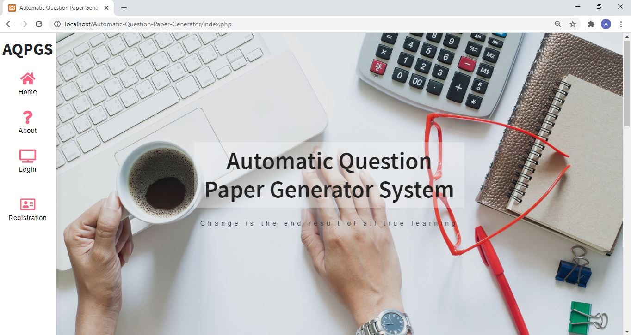
Prototype Design Demonstration Index Page

Slide 17
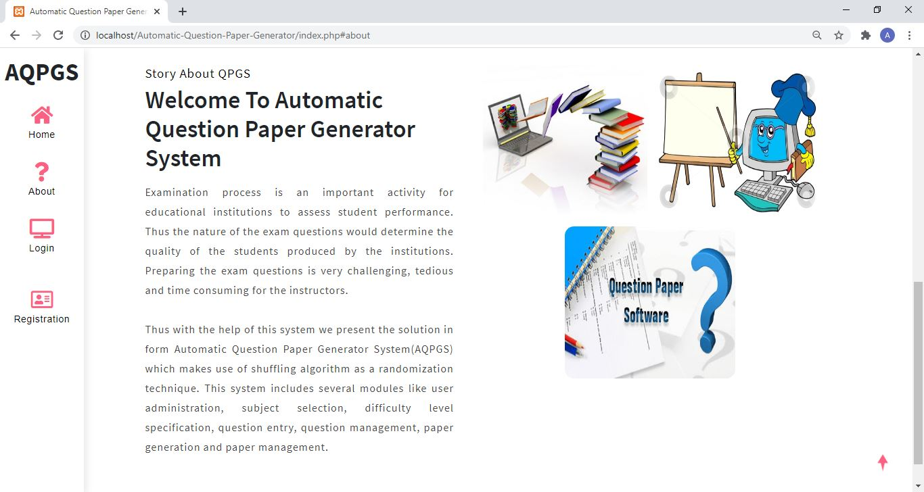
Prototype Design Demonstration About Page

Slide 18
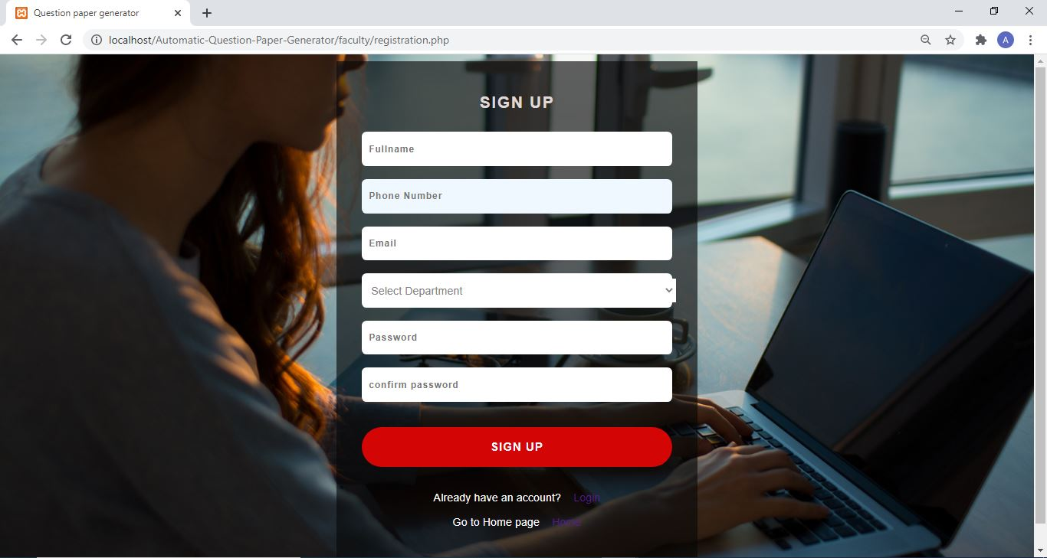
Prototype Design Demonstration Registration Form

Slide 19
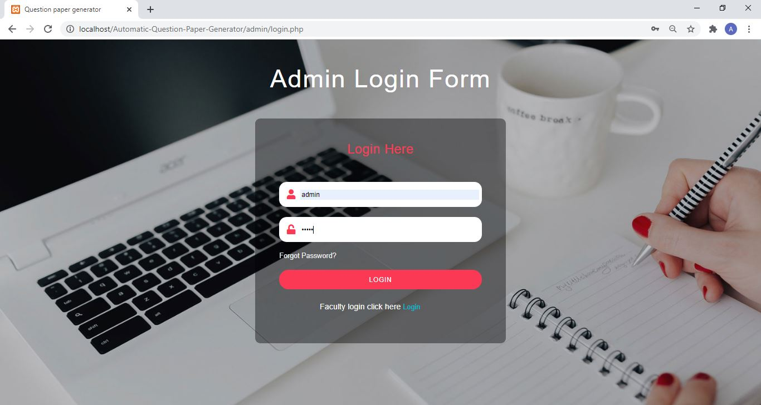
Prototype Design Demonstration Admin Login Form

Slide 20
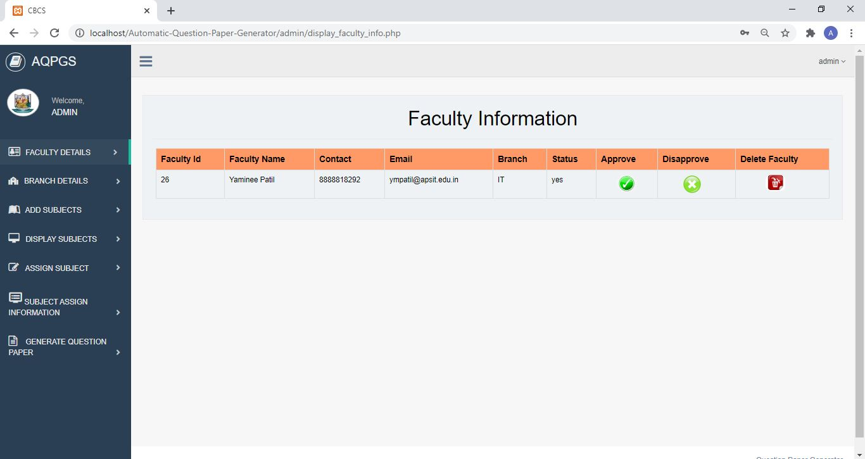
Prototype Design Demonstration Faculty Details

Slide 21
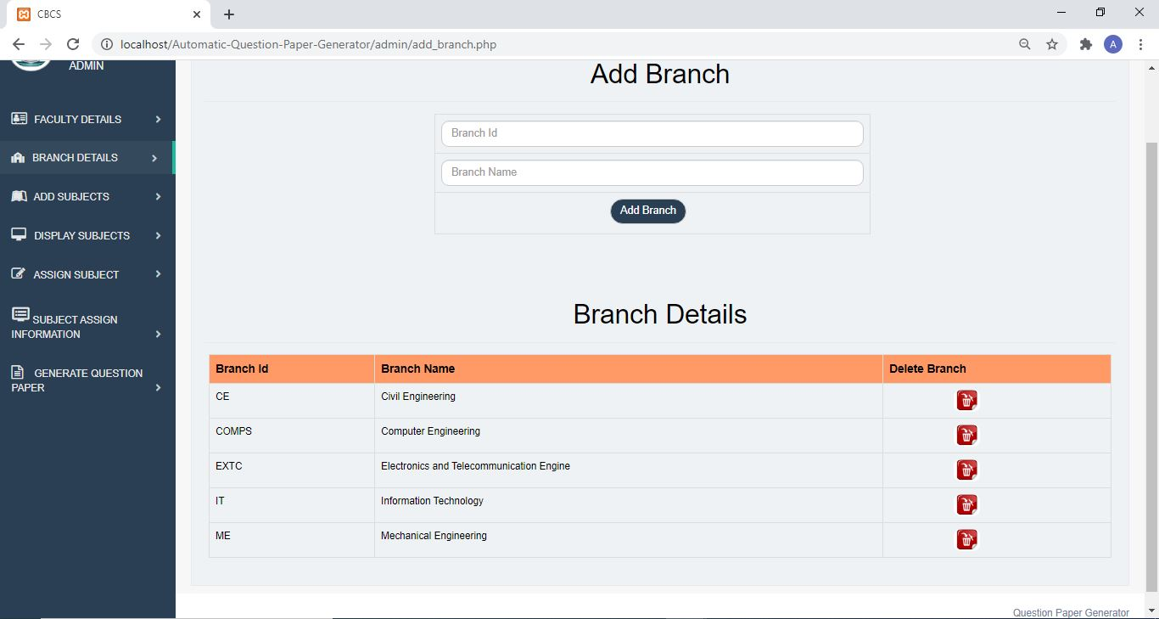
Prototype Design Demonstration Branch Details

Slide 22
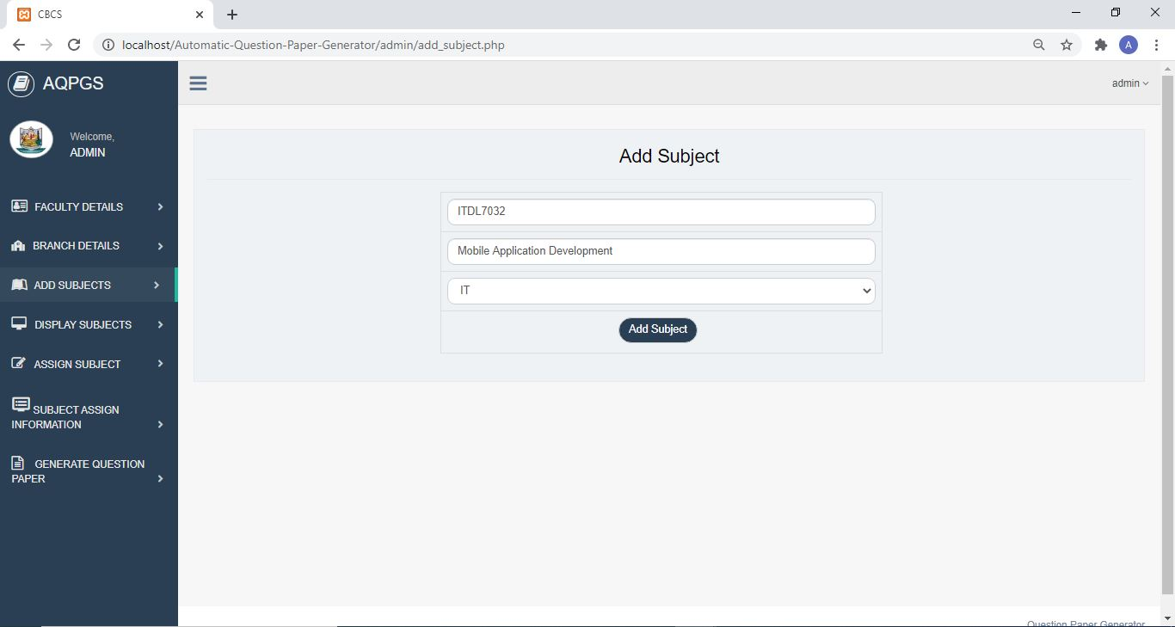
Prototype Design Demonstration Add Subjects Page

Slide 23
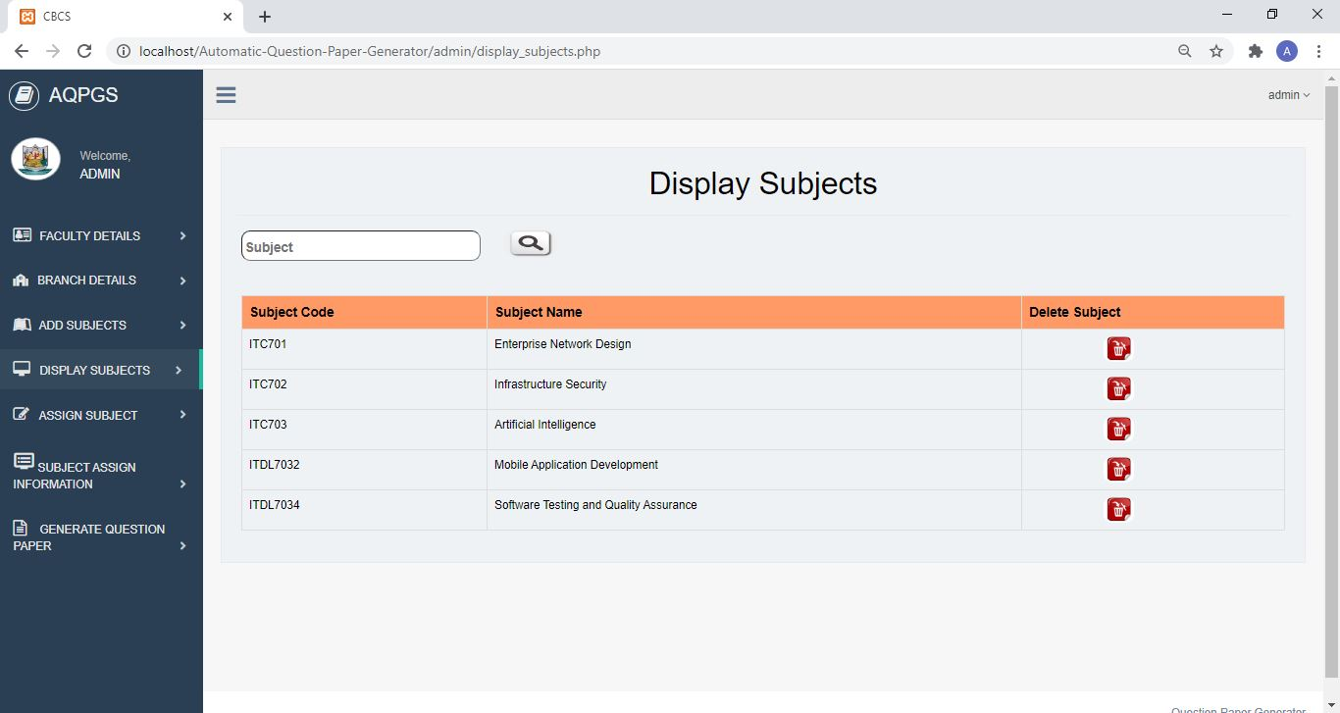
Prototype Design Demonstration Display Subjects Page

Slide 24
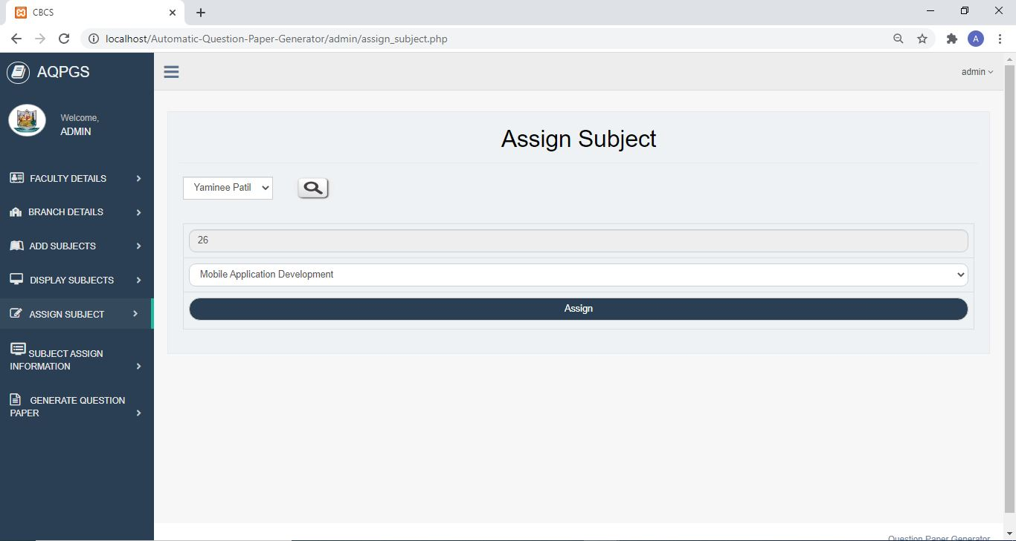
Prototype Design Demonstration Assign Subjects Page

Slide 25
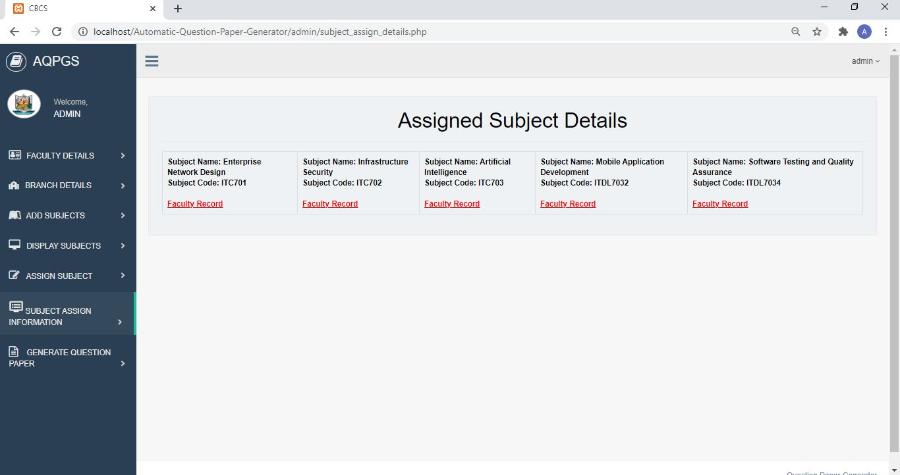
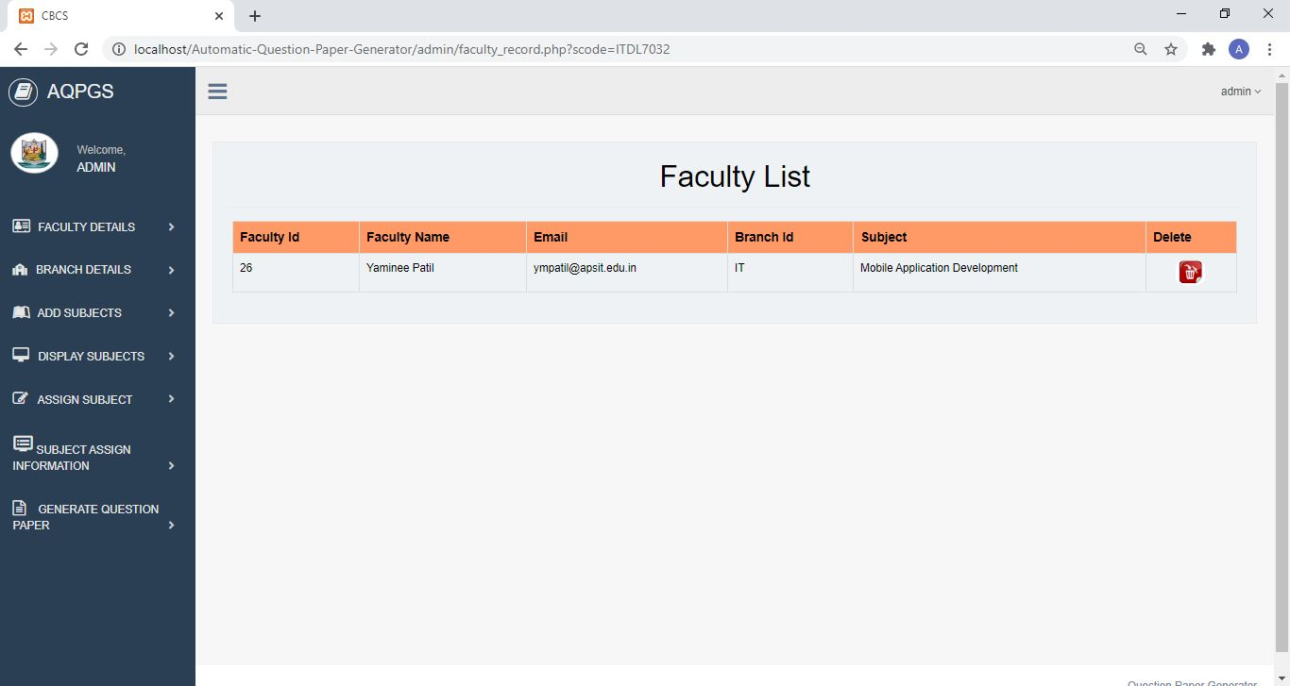
Prototype Design Demonstration Subjects Assigned Information Page

Slide 26
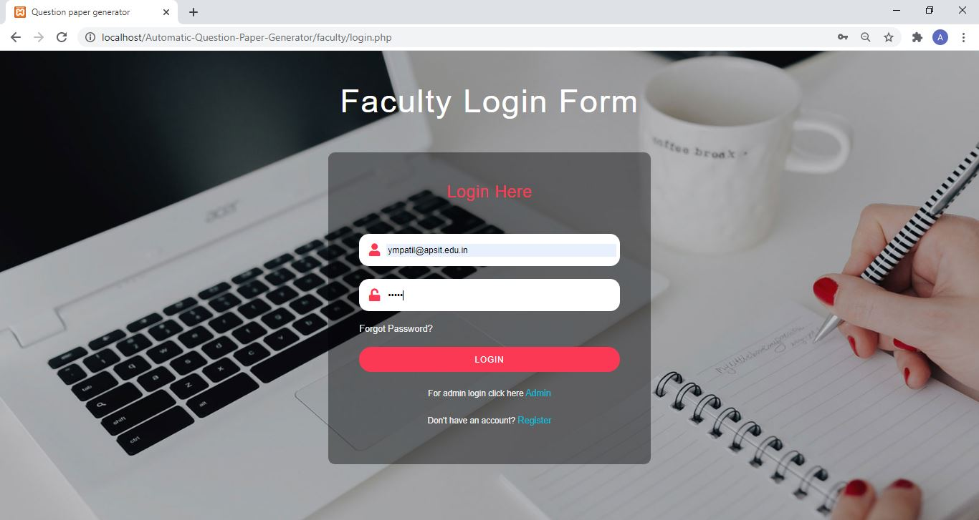
Prototype Design Demonstration Faculty Login Form

Slide 27
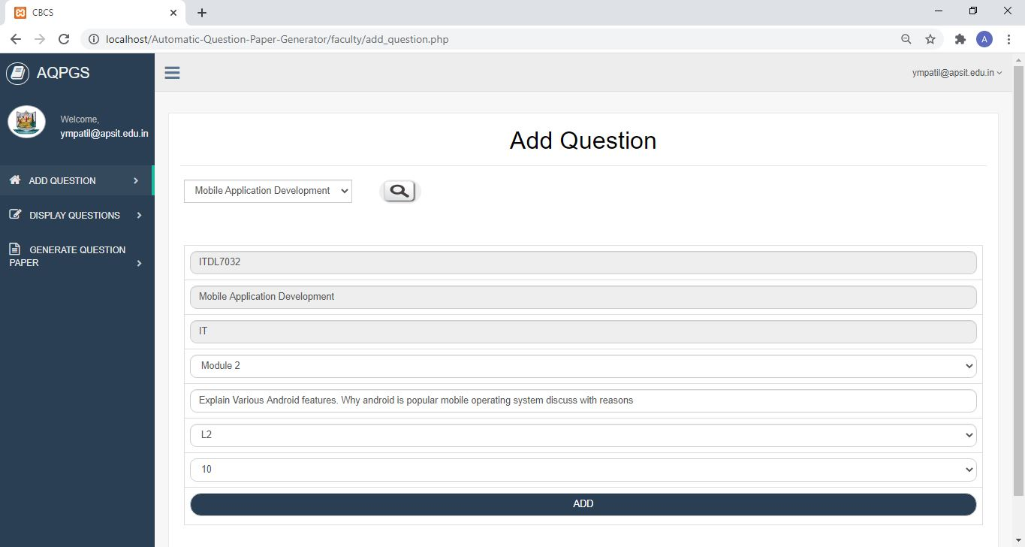
Prototype Design Demonstration Add Question Page

Slide 28
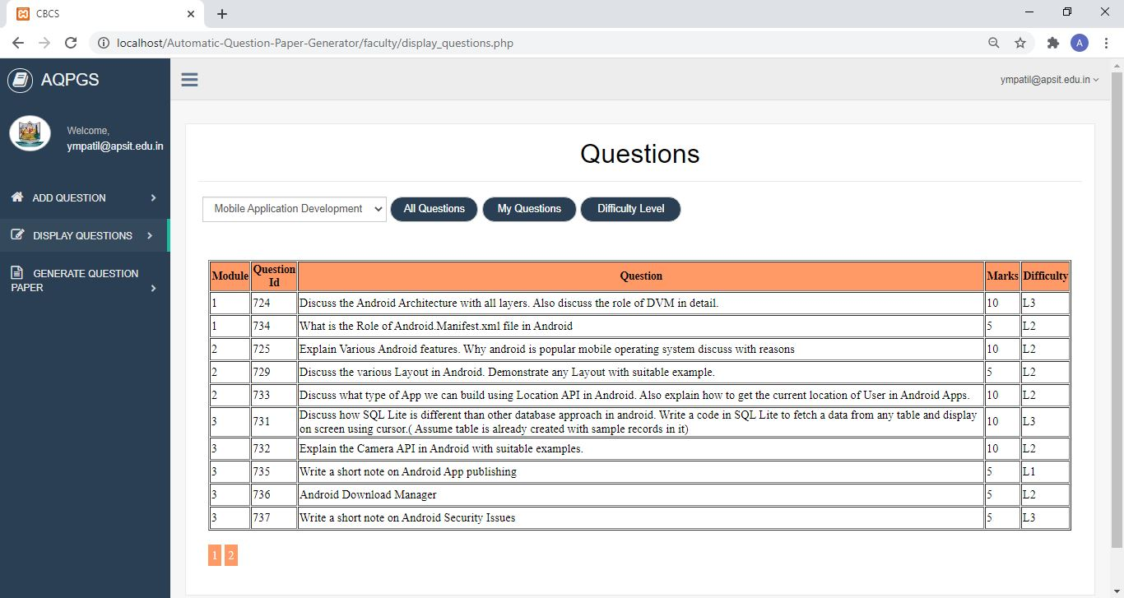
Prototype Design Demonstration Display Questions Page

Slide 29
Plan Of Paper Publication
Drafting of Paper complete.
Sr No. | Conference Name | Publication Name | Status
1. | ICACDS Nashik | Springer | Paper submitted. Awaiting Notification of Acceptance
2. | IEEE Conference, Bengaluru | IEEE | Paper Ready. To be submitted in a day or two.

Slide 30
Thank You...!!

